Slide 1
Rice Blast Disease Detection and Classification using Machine Learning Algorithm
Presented by
Sakib Rokoni
ID: 23273004
1

Slide 2
Introduction
What is Rice Blast Disease?
This disease is caused by a fungus named Pyricularia orizae, which overwinters in rice seeds and infected rice stubble.
The fungus reproductive structures, spores, can spread from these two sources to rice plants during the next growing season and initiate new infections.
Existing Methods
Libo Liu et al (2009), proposed the concept of BP neural network classifier to identify the disease and healthy part of the rice leaves. The rice disease considered here is a brown spot.
M. Jhuria et al (2013) proposed the neural networks algorithms to detect and monitor the disease for the fruits plants from plantation to harvesting.
H. Q. Cap et al (2018) proposed the concept of computer based methods to detect plant diseases.

Slide 3
Data Collection
Images are acquired from the rural area of the Panpoli Village, Shencottai taluk, Tirunelveli district, Tamilnadu. Total 300 leaf samples are taken from both normal and infected part of the field.
Images are captured using Moblie Camera with high resolution and then resized into 256x256pixels
During image pre-processing, the RGB images are converted into HSV images, since working with HSV is very easier to separate the colors.
The HSV represents the Hue, saturation and value part of the images

Slide 4
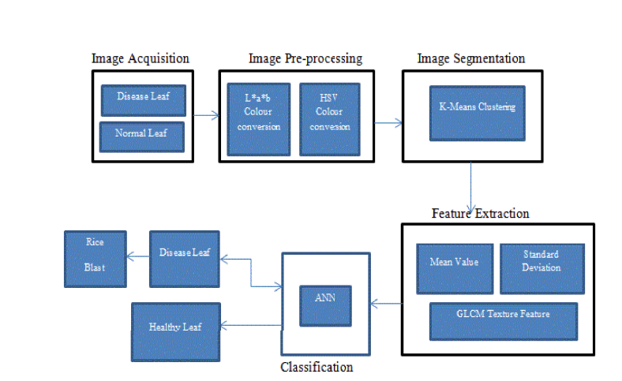
Data Preprocessing
Image processing is a standard method for identifying different illnesses on rice plants. It is also concluded that digital camera capture is routine and excellent for early research. Automatic plant disease detection is needed to boost agriculture production today. Machine learning is used to automatically detect disease in this article

Slide 5
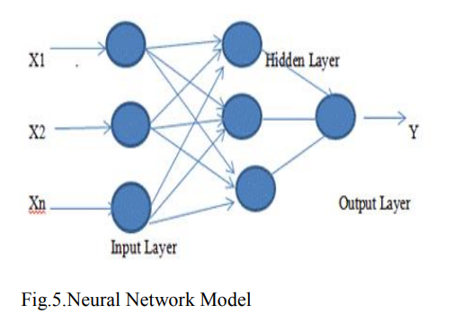
Classifications
An artificial neuron network (ANN) is a computational model based on the structure and functions of biological neural networks.
ANN consists of three layers, which are interconnected to each other.
The first layer (input neurons) sends the data to second layer (hidden layers), the second layer sends proposed data to the third layer (output neurons).

Slide 6
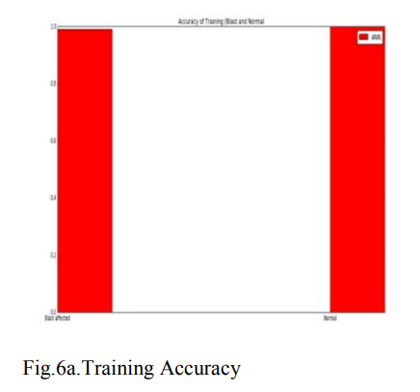
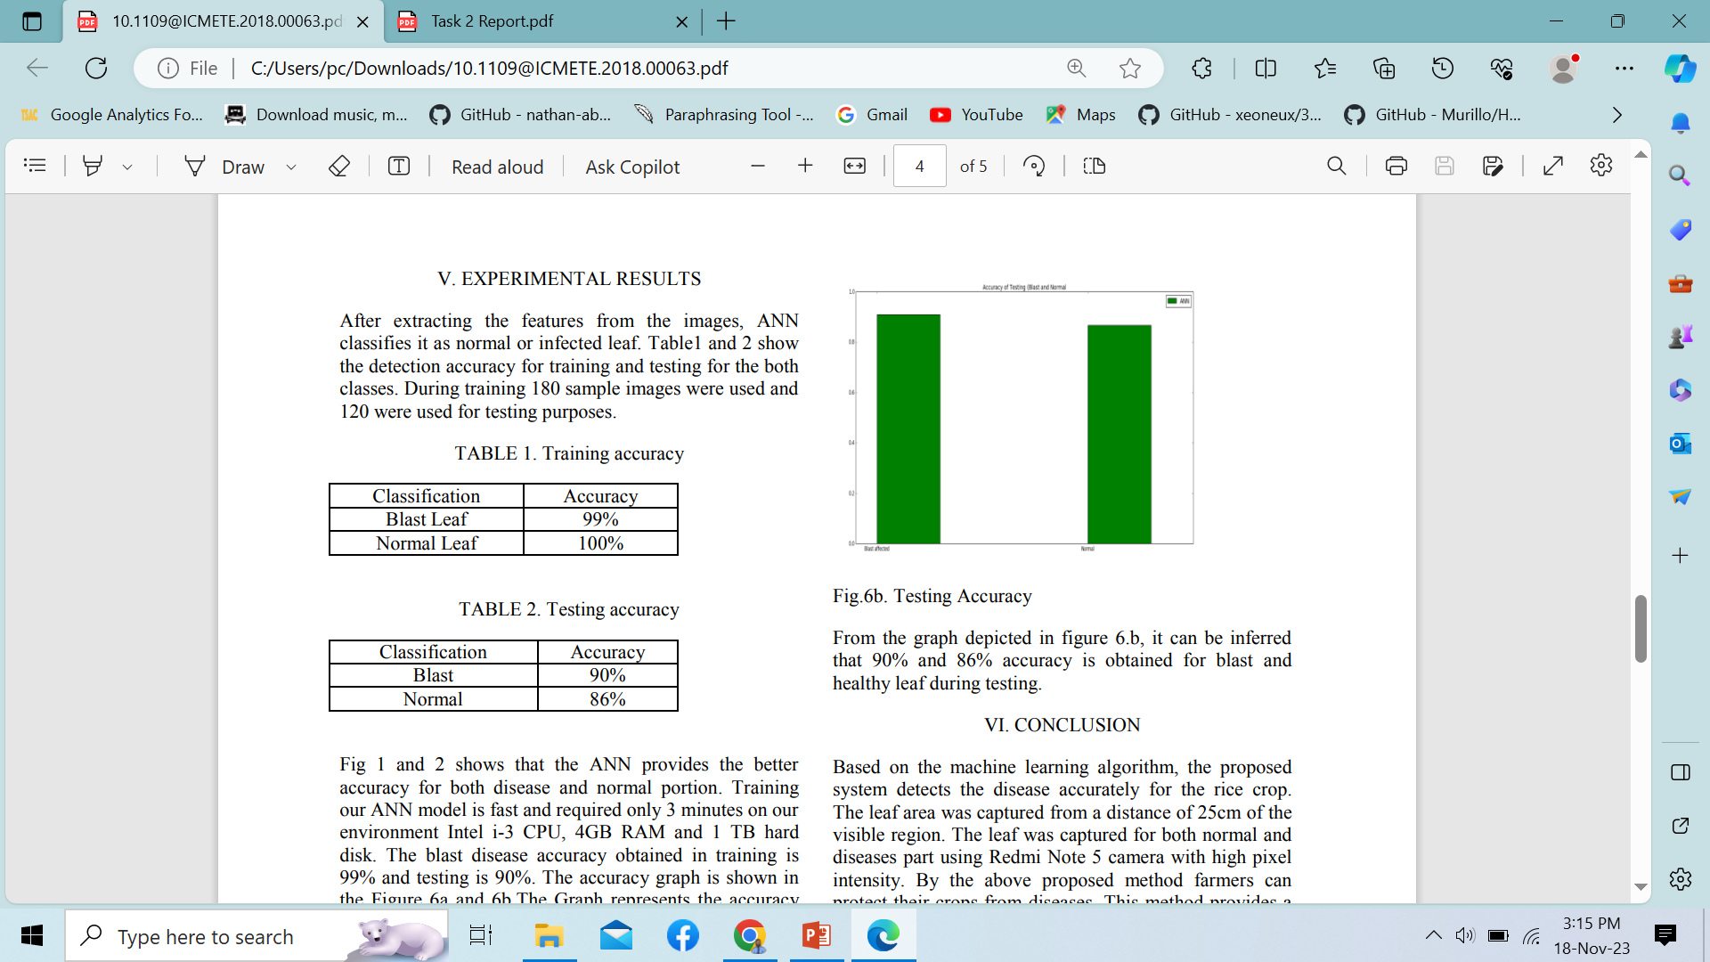
Experimental Result
After extracting the features from the images, ANN classifies it as a normal or infected leaf.
During training 180 sample images were used and 120 were used for testing purposes.
It can be seen that 99% and 100% accuracy is obtained for blast and healthy leaf during training. Fig.6b. Testing Accuracy From the graph depicted in figure 6.b, it can be inferred that 90% and 86% accuracy is obtained for blast and healthy leaf during testing.

Slide 7
Conclusion & Future Works
Image Acquisition -> Image Pre-processing -> Image Segmentation -> Feature Extraction -> Classification - > Results
Helpful for the farmers to detect diseases earlier and to take necessary steps for prevention
Still there are no perfect screening tools for the Detection of Rice Blast Disease
In the future, more images with high pixels are required by the authors to improve the existing model.

